Slide 1

YELP
These reviews are too biased!

Slide 2
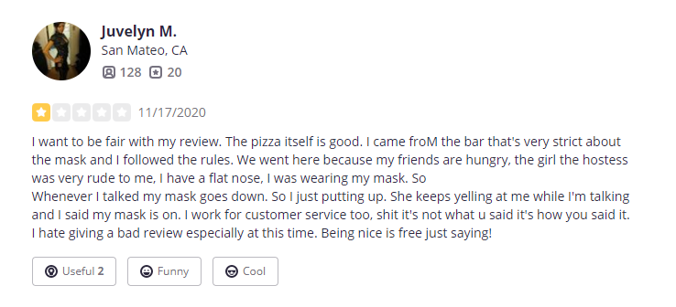
Tell me more...
Yelp Reviews have a lot of moments where you find a star review not quite aligning to the text.

Slide 3
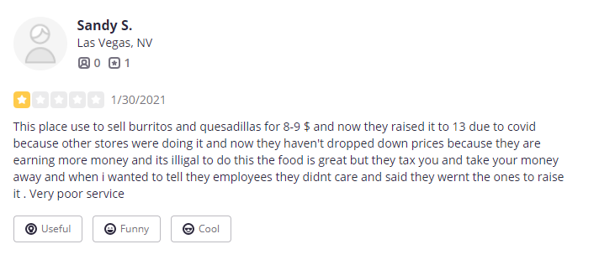
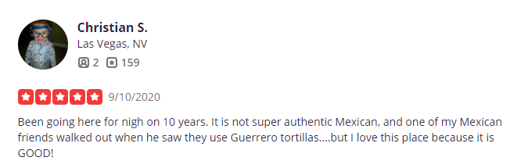
More examples of incongruous star allocation on reviews,

Slide 4
The Data - Provided by Yelp for Academic Purposes
8.6 Million Reviews
2.2 Million Users
160 Thousand Businesses
This is only a fraction of what is on Yelp and I will merge the 3 dataframes and only sample 1% of the data.
We will move forward with a collection of 86,345 reviews!
Which we will model 10% of after filtering to only food businesses. (6,081 reviews)

Slide 5
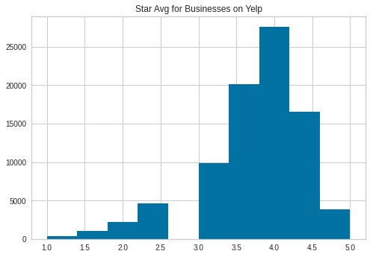
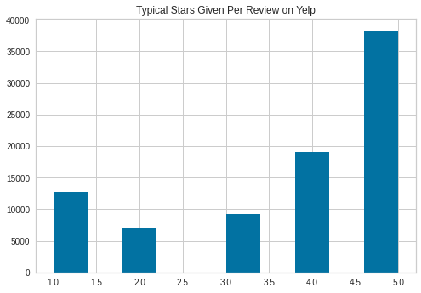
Can Machine Learning Translate Stars Better?
Let’s looks at the Larger Yelp data set of millions of reviews

Slide 6
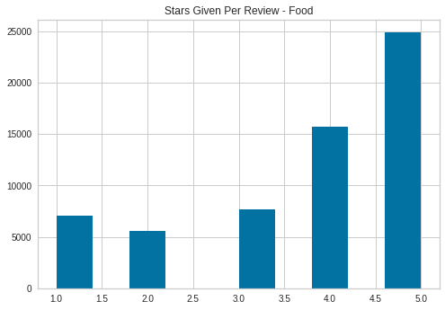
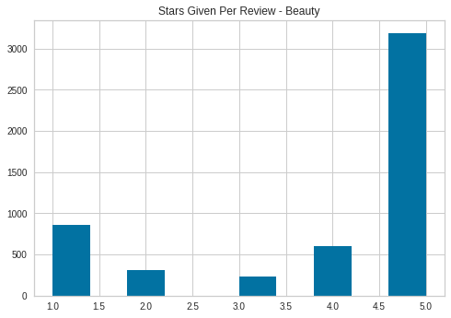
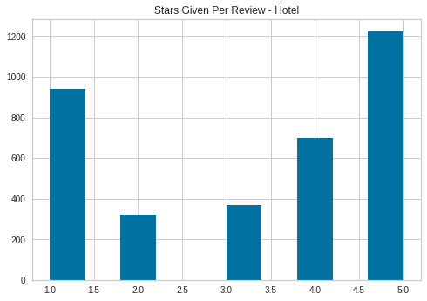
Review Breakdown by Industry; Food, Beauty, Travel
Reviewers seem most critical of Hotels with low ratings, and give the highest ratings to Beauty businesses.

Slide 7
Create some Features to better understand the data.
Fan = A binary calculation that gives a 1 if the reviewer rates the business higher than their average star.
Fb_ratio = The amount of feedback given by other users to that review, shows how helpful the review was.
Star_diff = the difference between the current review and the average biz review.

Slide 8
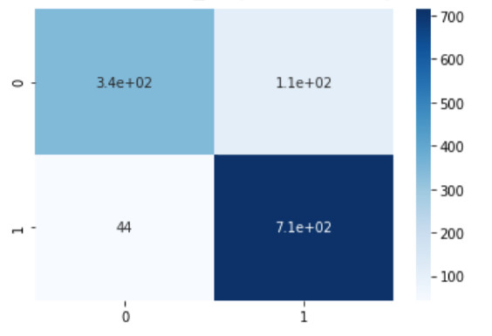
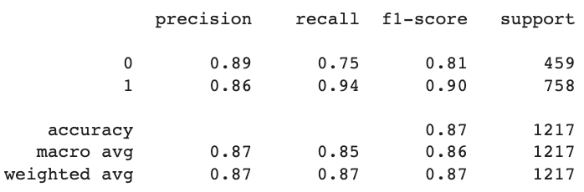
Naive Model - Random Forest Classifier
This will set a performance baseline to see how well the model can solve for the ‘fan’ feature based on text, biz_star, user_rev_sum, biz_rev_sum, fb_ratio, & star_diff.
Strong result, need more granularity.

Slide 9
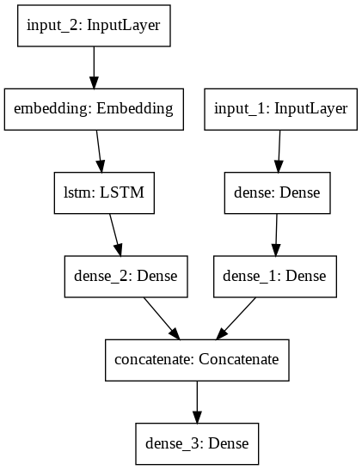
2 Input, One Output LSTM / Dense Neural Net
We will preprocess the text and the numbers separately and then join them in the model.
Using this style of model returns classification probability which will help us assess an alternative star rating.

Slide 10
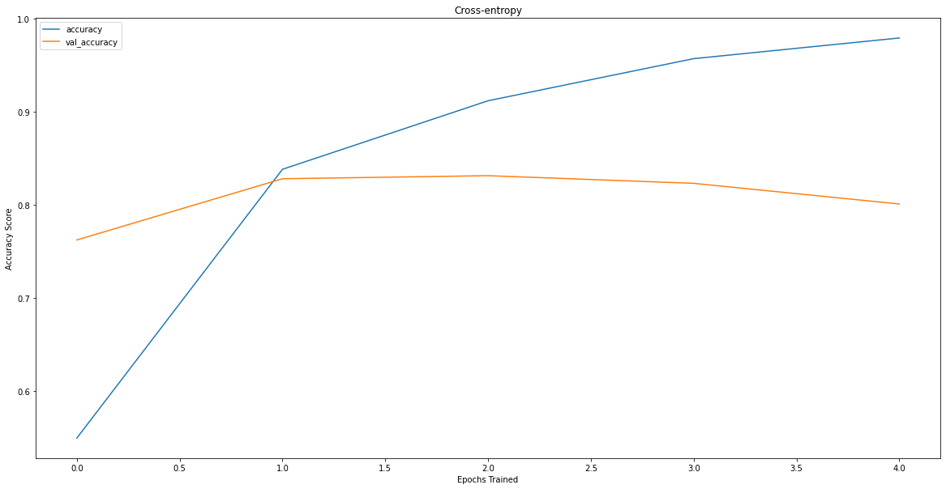
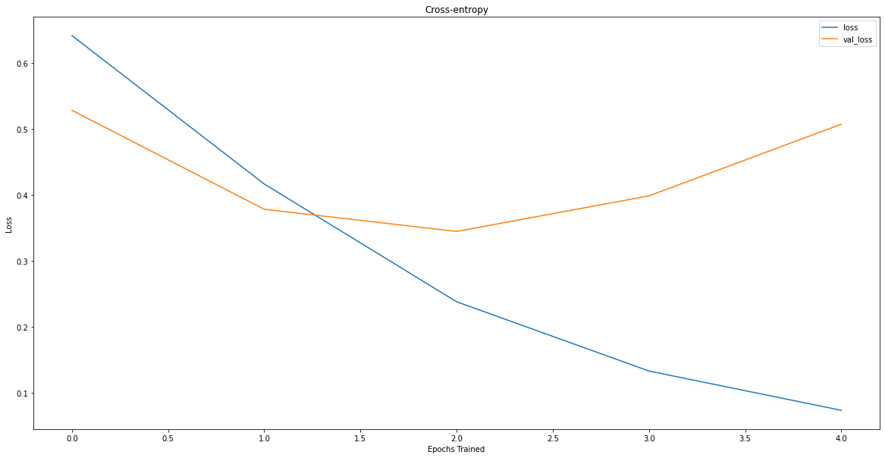
Results of NN model
We have slightly lower accuracy performance with the current parameters but more granular data as the output gives us probability towards 0 / 1 target.

Slide 11
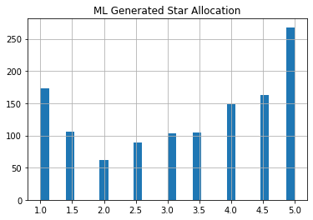
ML created Star rating distribution
This is less biased to 5 star ratings and gives a more intuitive grading scale.
Over time this algorithm can be tweaked as the model improves.

Slide 12
Next Steps, improving model performance.
Deeper feature engineering, can get more creative with designing informative features.
Tuning the parameters - play with parameters in both models or even try other model types.
More NLP techniques. Can try Word2Vec, or creating bigrams and trigrams to improve sentiment understanding in the review docs.

Slide 13
Next Steps, To Production and Beyond
When the model is showing stronger results, build functions to transform new data and give alternate reviews as people make reviews.
The feature could even suggest a star score based on what was written before the review is posted.
Create new features that can bring new data points to the site that will improve model performance.

Slide 14
def grade_star(x): # Create a star value based on predicted probability of how much a business was liked.
if x > .998:
return 5
elif x >= .989:
return 4.5
elif x >= .94:
return 4
elif x >= .8:
return 3.5
elif x >= .5:
return 3
elif x >= .25:
return 2.5
elif x >= .08:
return 2
elif x >= .02:
return 1.5
else:
return 1

